Slide 1
CS 4530
Software Engineering
Lecture 1 - Course Overview + Introductions
Jonathan Bell, John Boyland, Mitch Wand
Khoury College of Computer Sciences

Slide 2
Today’s Agenda
Introductions
Course Mechanics
Discussion: Code style
Code style activity

Slide 3
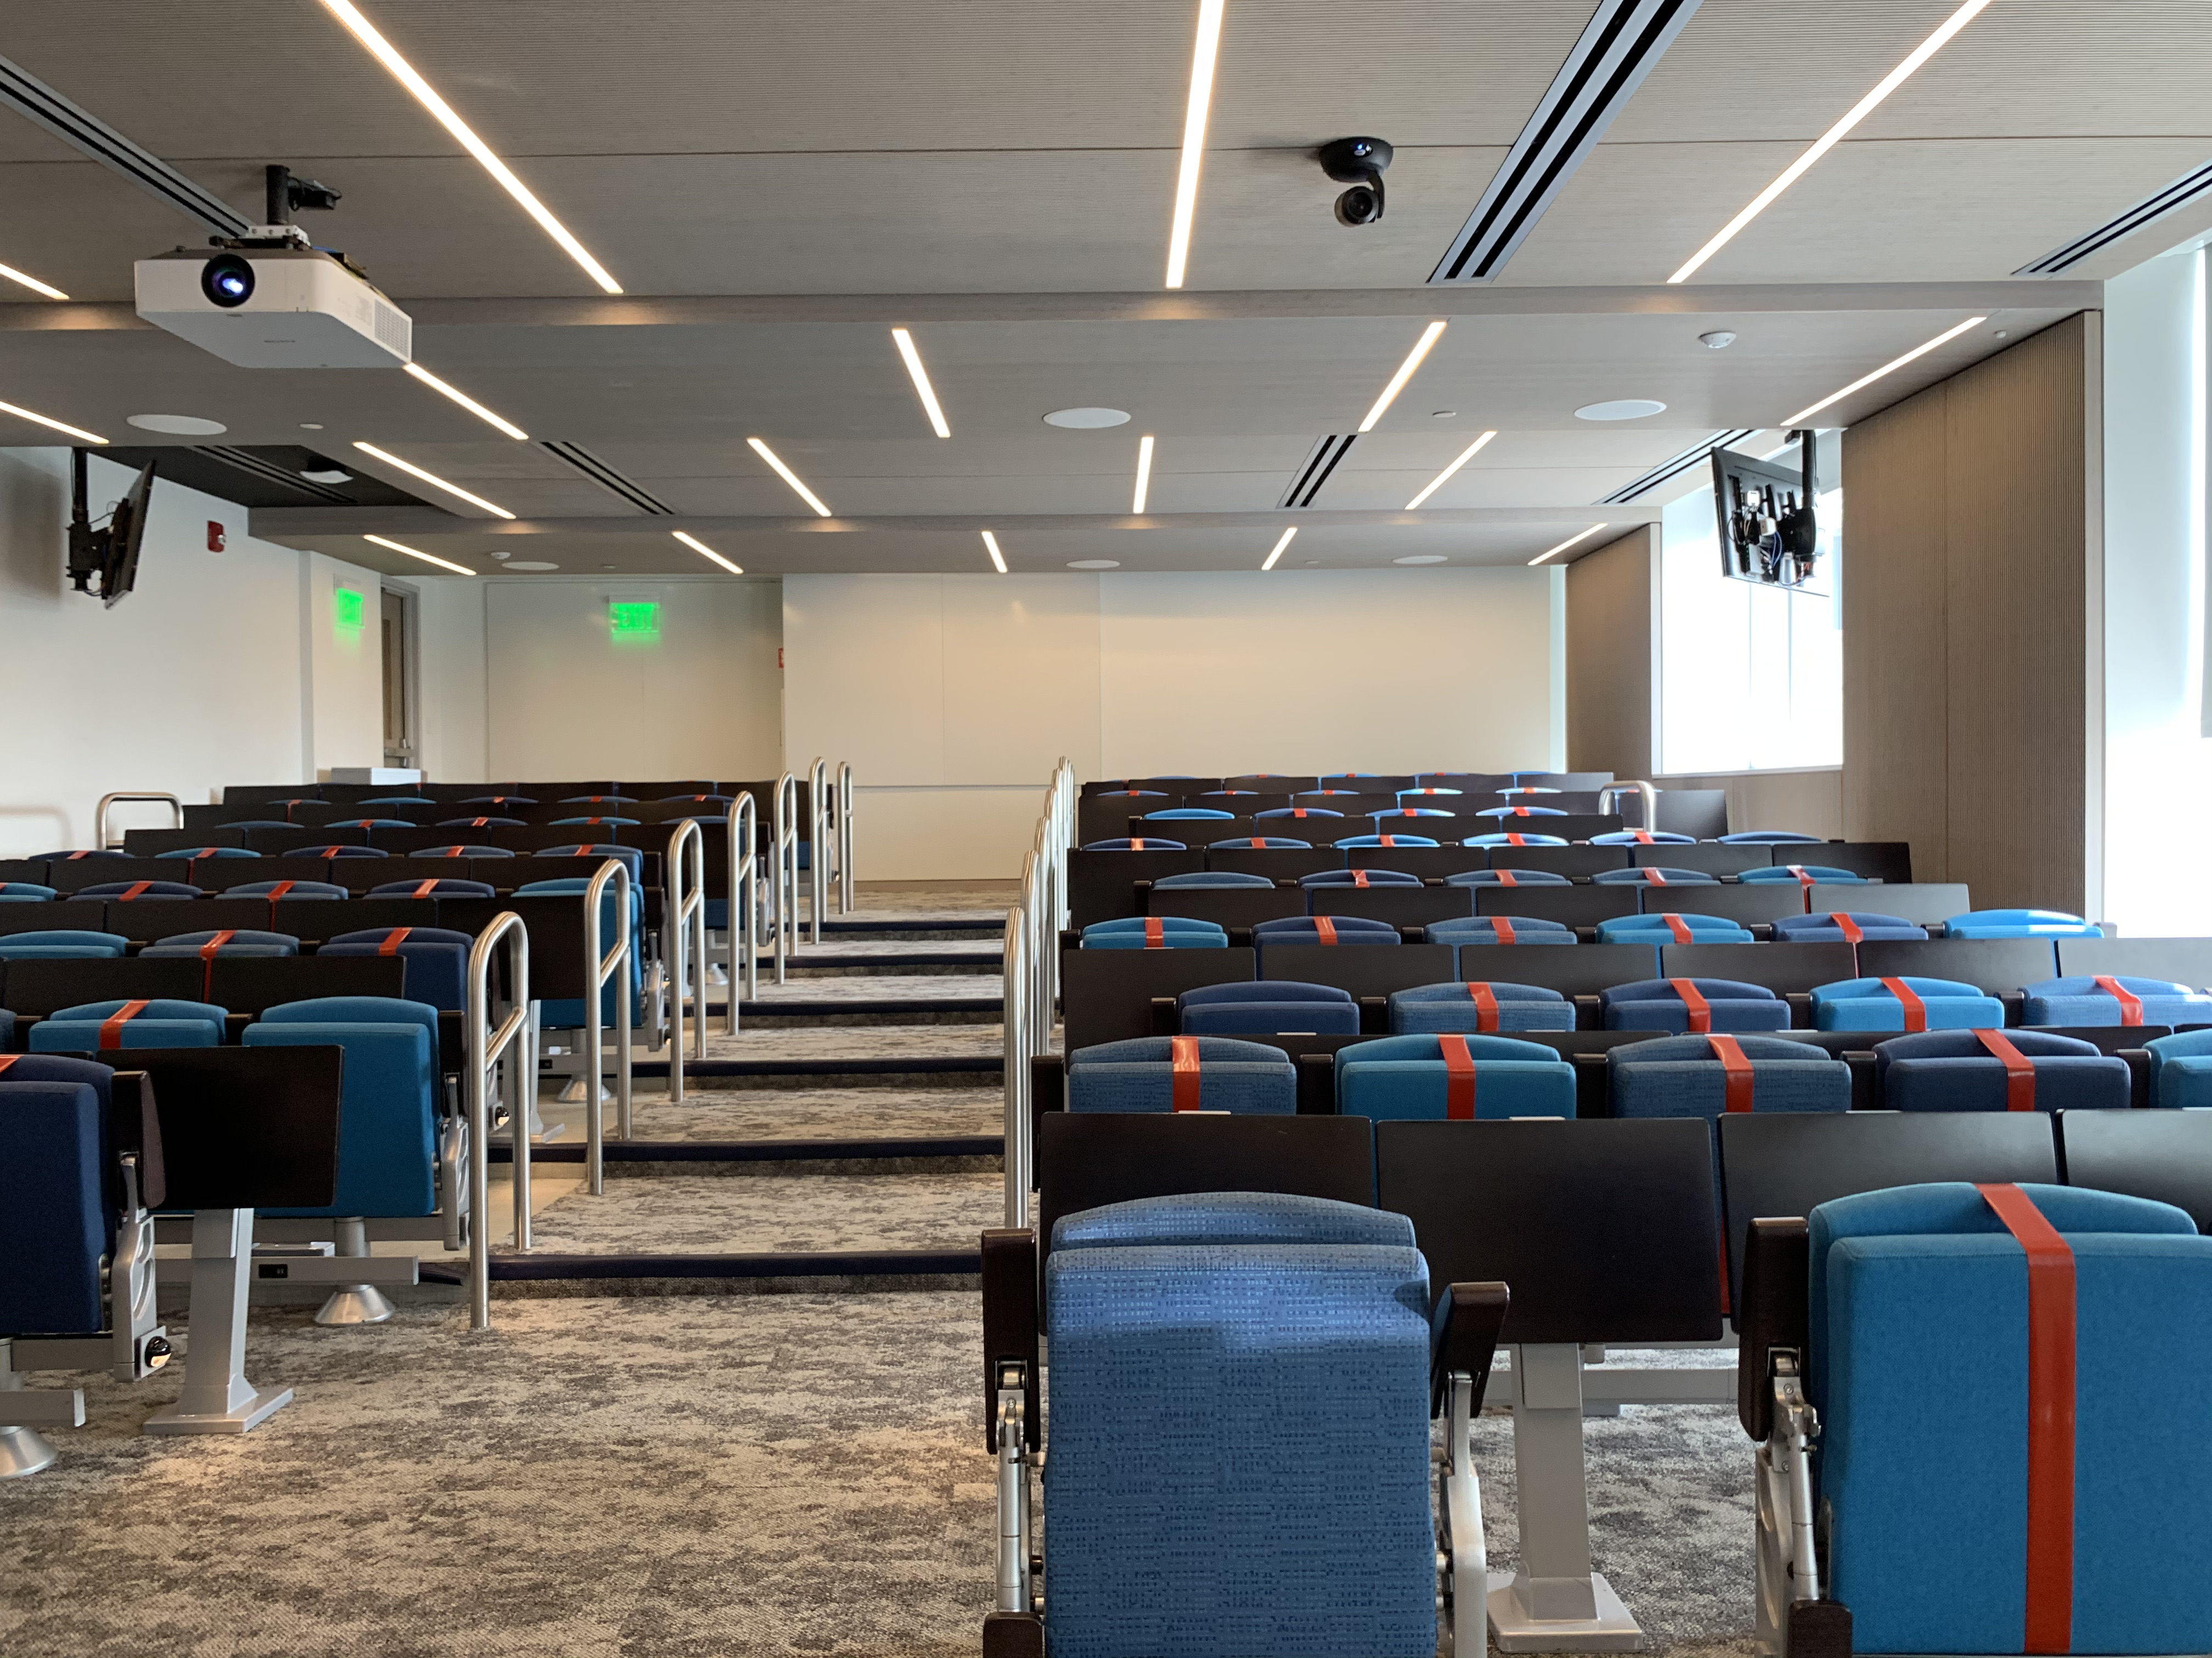
Zoom Mechanics
Recording: TBD
If you feel comfortable having your camera on, please do so! If not: a photo?
I can see the zoom chat while lecturing, slack while you’re in breakout rooms
If you have a question or comment, please either:
“Raise hand” - I will call on you
Write “Q: <my question>” in chat - I will answer your question, and might mention your name and ask you a follow-up to make sure your question is addressed
Write “SQ: <my question>” in chat - I will answer your question, and not mention your name or expect you to respond verbally

Slide 4
Introductions
Me
Research: Software Engineering, Program Analysis
Open source startup: Clowdr (Virtual conferences - React/NodeJS/Vonage/Hasura/Postgres)
Reminder of coordinated sections with:
Professor John Boyland
Professor Mitchell Wand

Slide 5
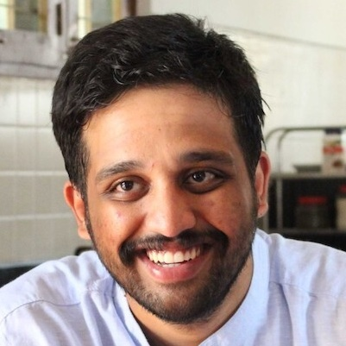
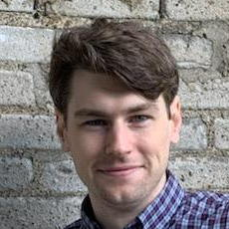
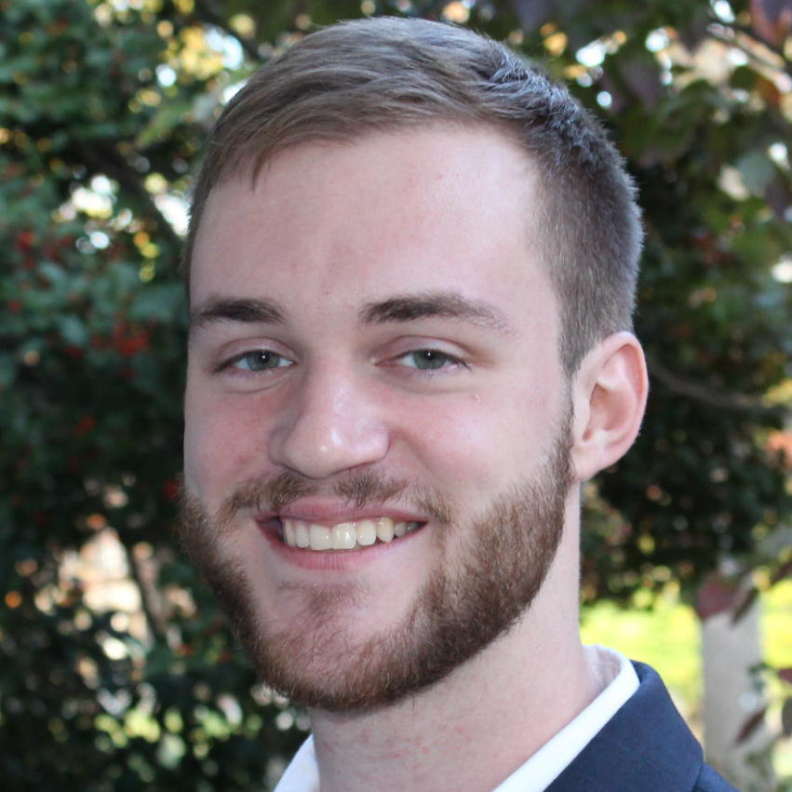
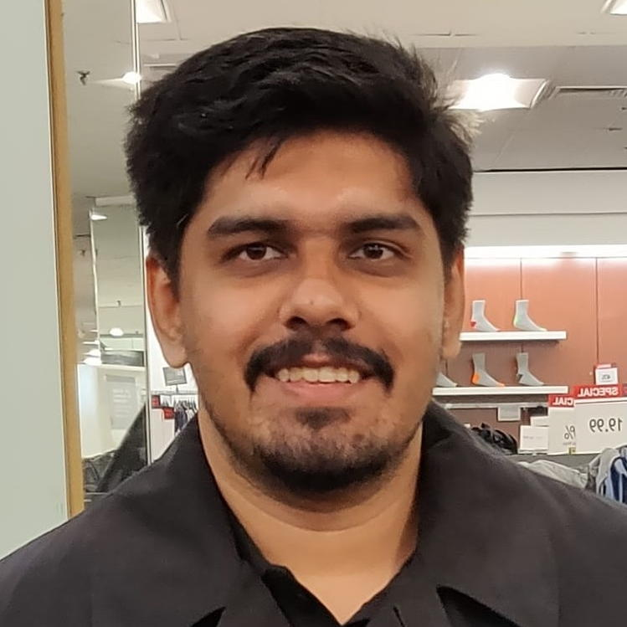
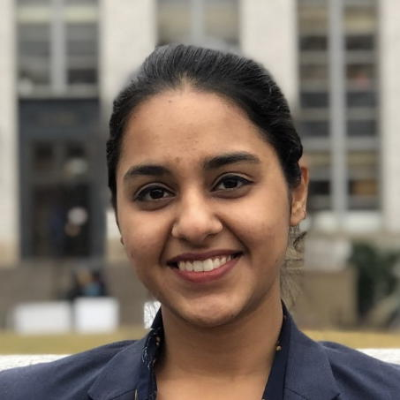
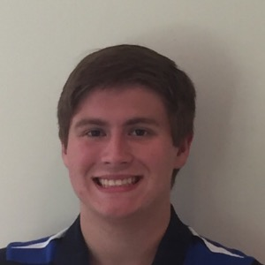
Teaching Assistants
Sagar Madhu Ayi
Joseph Burns
Michael Davinroy
Yuting Gan
Eiki Kan
Satyajit Gokhale
Guneet Kaur
Ben Schultze
Office hours: 5 days a week
Monday: Sagar Madhu Ayi @ 1:30-3:30PM, Yuting Gan @ 4:30PM - 6:30PM
Tuesday: Benjamin Schultze @ 3:00PM - 5:00PM
Wednesday: Joseph Burns @ Noon-2:00pm, Eiki Kan @ 4:35PM - 6:35PM
Thursday: Michael Davinroy @ 1:00PM - 2:00PM
Friday: Michael Davinroy @ 9:00AM - 10:00AM, Guneet Kaur @ 11:00AM- 1:00PM

Slide 6
Introductions [Poll]
https://pollev.com/jbell

Slide 7
Course Mechanics
See syllabus for all of the usual stuff
Our goal is to provide a productive learning environment to both remote and on-the-ground students
Lecture videos posted at start of week: watch videos before coming to class
During scheduled class time: discussion, activities. If you come in person, bring laptop and headphones
Note: 10% of course grade is based on your participation in these activities
Please contact me if you are regularly not able to attend class due to extreme difference in time zone

Slide 8
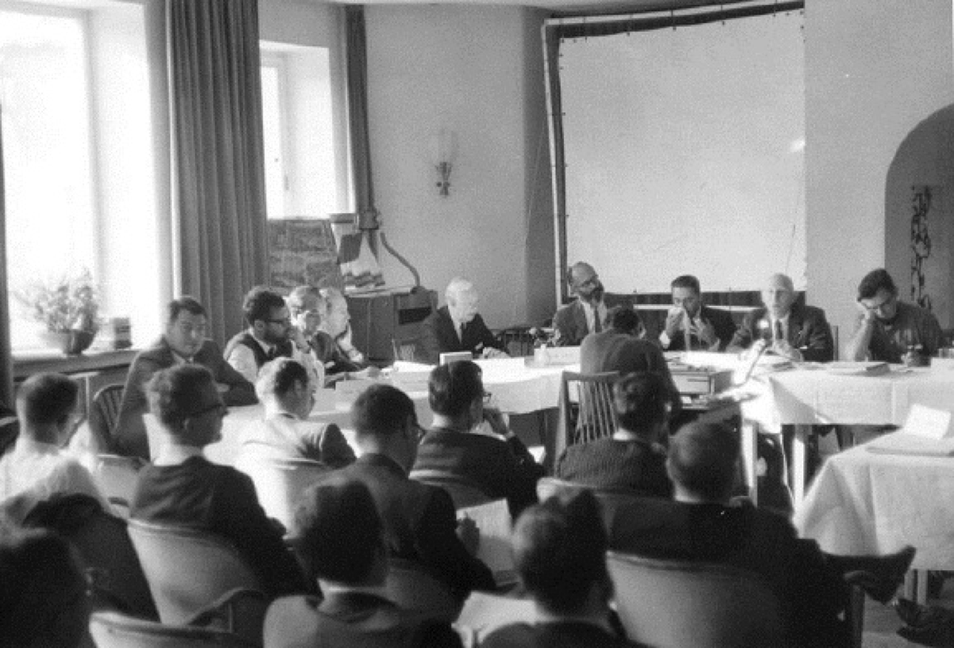
Software Engineering as a Discipline c. 1969
[Software Engineering as a Class]
Software was very inefficient
Software was of low quality
Software often did not meet requirements
Projects were unmanageable and code difficult to maintain
Software was never delivered
A call to action: We must study how to build software

Slide 9
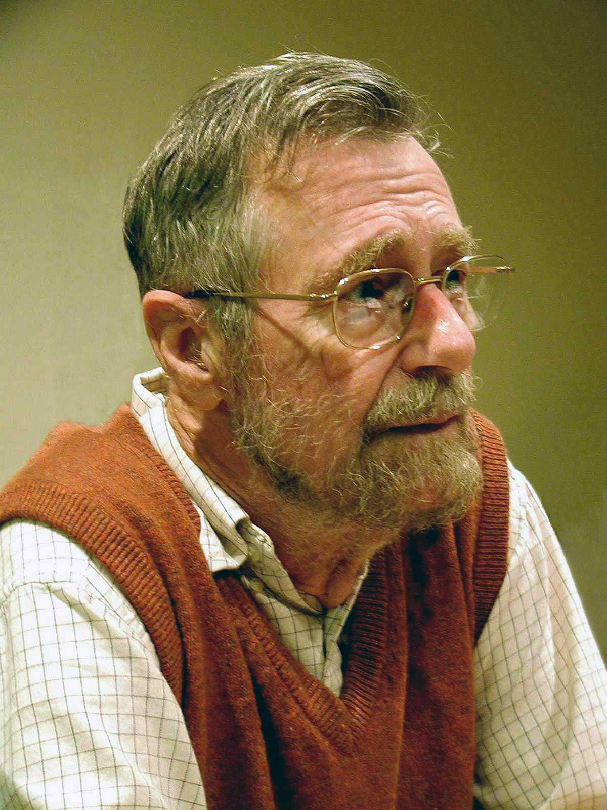
Software Engineering as a Discipline
[Software Engineering as a Class]
The major cause of the software crisis is that the machines have become several orders of magnitude more powerful! To put it quite bluntly: as long as there were no machines, programming was no problem at all; when we had a few weak computers, programming became a mild problem, and now we have gigantic computers, programming has become an equally gigantic problem.
- Edsger W. Dijkstra, in his 1972 Turing Award acceptance speech

Slide 10
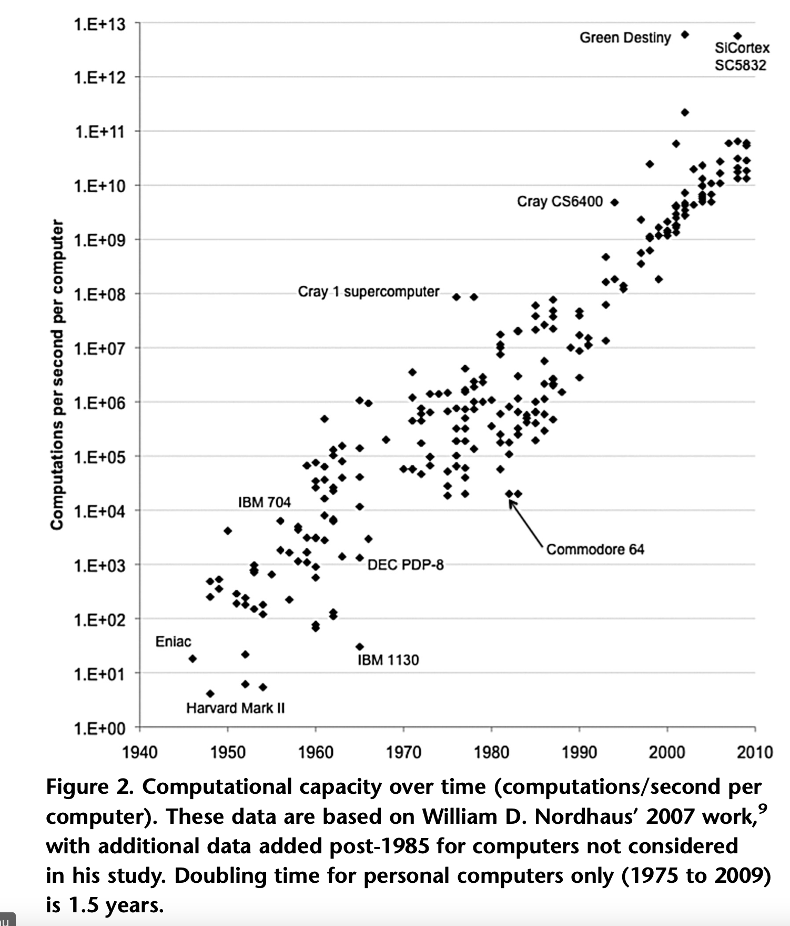
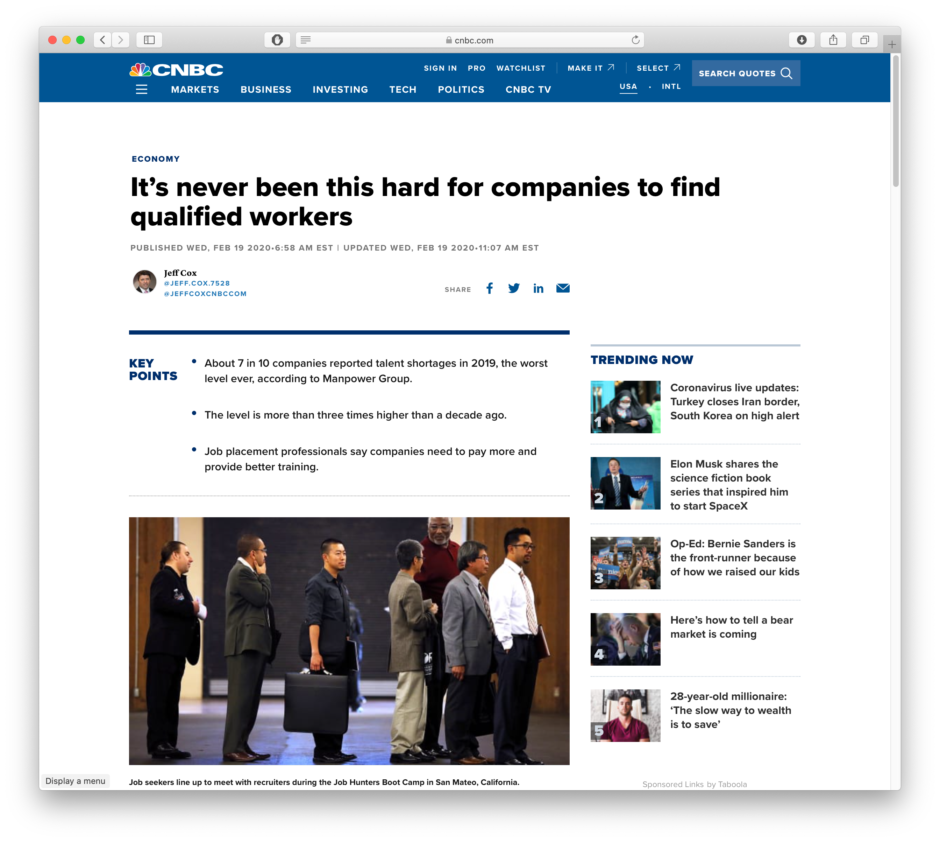
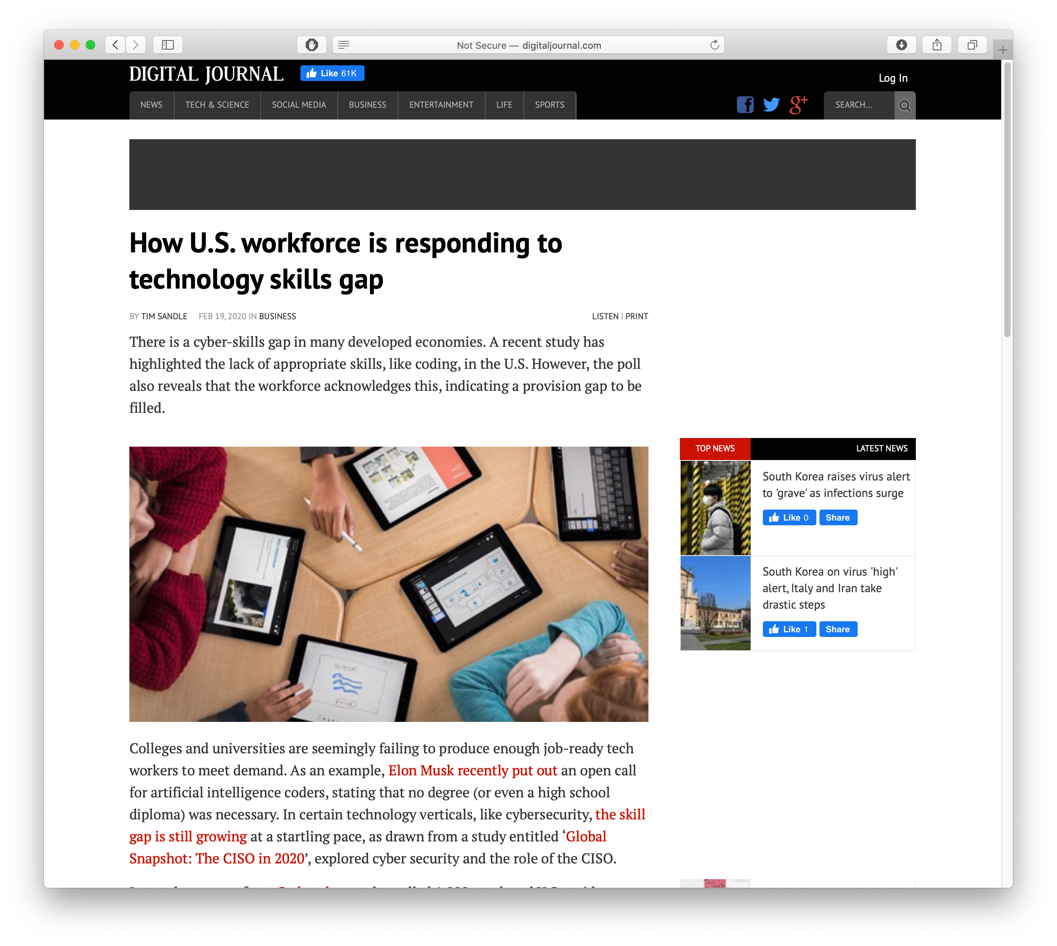
Increase in computational capacity over time
Increase over software complexity?
“Implications of Historical Trends in the Electrical Efficiency of Computing” Koomey et al, IEEE Annals of History of Computing 2011

Slide 11
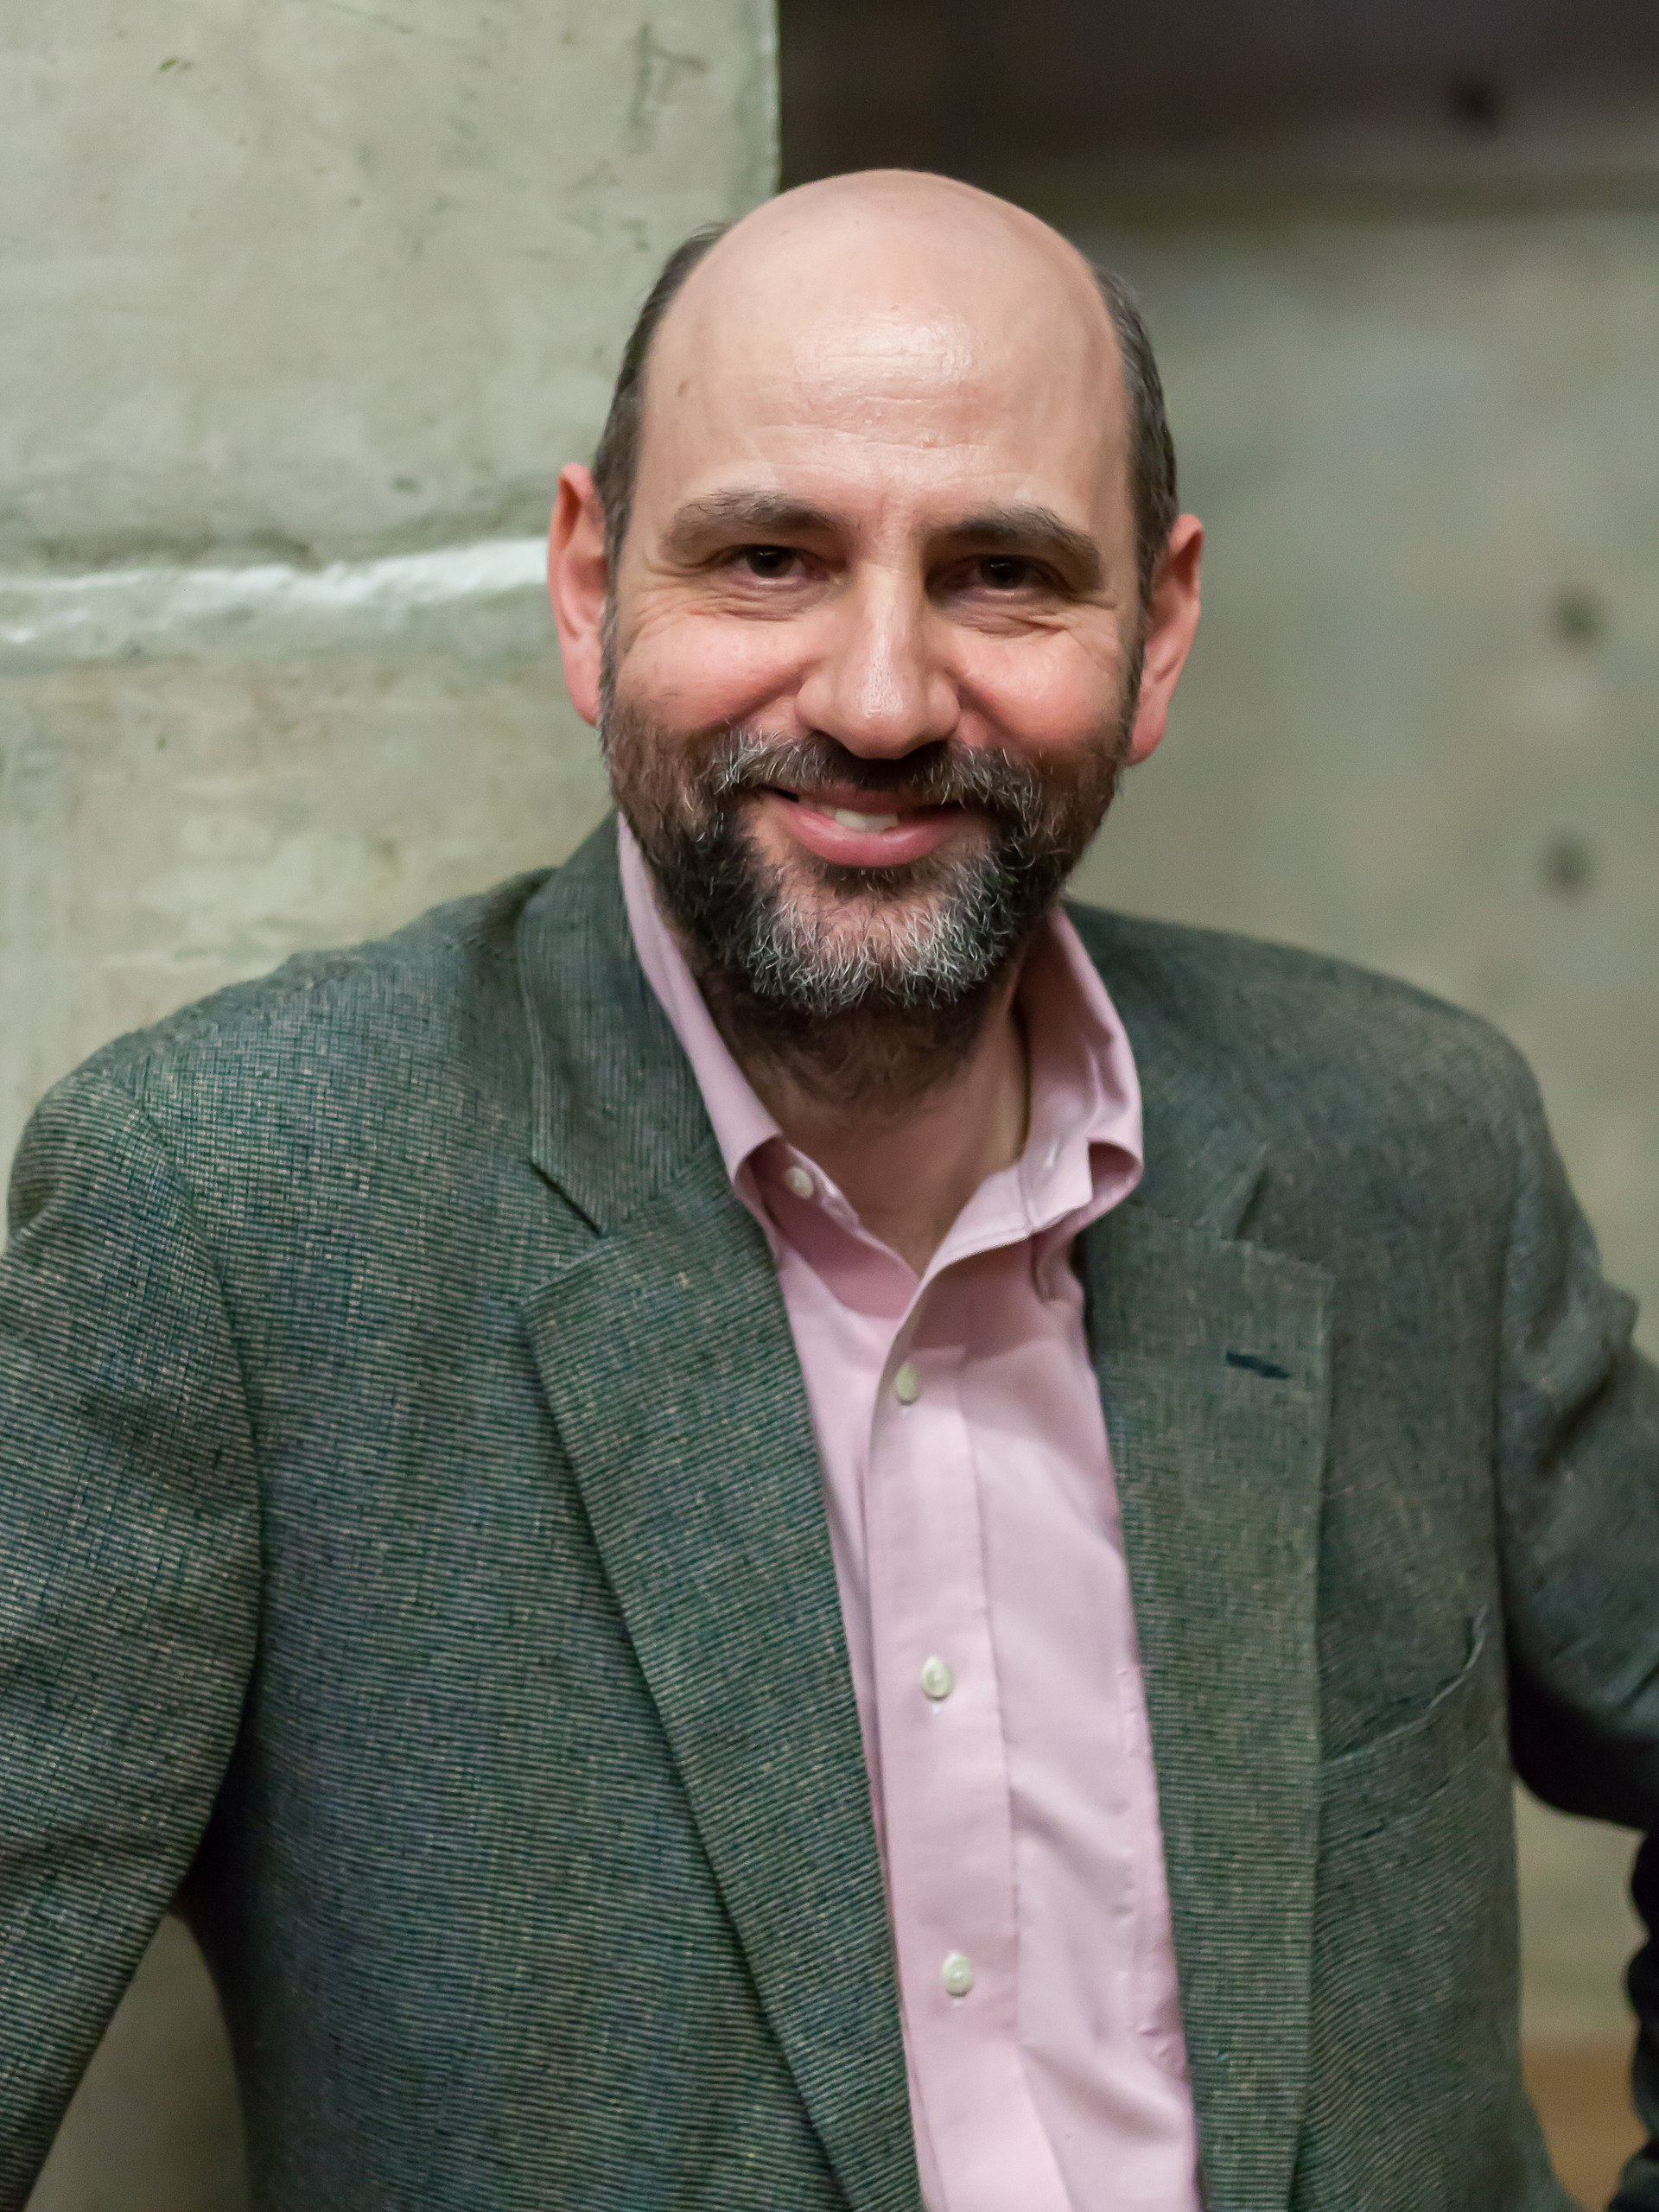
Software Engineering is about People
Disclaimer: Software Engineering is full of opinions
“Any fool can write code that a computer can understand. Good programmers write code that humans can understand”
- Martin Fowler

Slide 12
Why be pedantic about software design?
Software Engineering is about People
function calculateFoo(x: number, y: number, increment: boolean): number {
if (increment)
x++;
x *= 2;
x += y;
return x;
}
calculateFoo(3, 5, true) = ? calculateFoo(3, 5, false) = ?
13
8
11

Slide 13
Why be pedantic about software design?
What’s wrong with this code?
function anotherExample(value: number): void {
switch (value) {
case 1:
doSomething();
case 2:
doSomethingElse();
break;
default:
doDefaultThing();
}
}

Slide 14
Software Engineering is about People
Software design is about people
HashSet<String> mySet = new HashSet<String>();
mySet.add("a");
mySet.add("b");
Iterator<String> iter = mySet.iterator();
System.out.println(iter.next()); //What is printed?
This class implements the Set interface, backed by a hash table (actually a HashMap instance). It makes no guarantees as to the iteration order of the set; in particular, it does not guarantee that the order will remain constant over time. This class permits the null element.
-JavaDoc for HashSet
1,000,000 trials: “a” is printed every time
BUT NOT GUARANTEED

Slide 15
Software Engineering is about People
Software is about People
class BookTest {
@Test
public void testGetStringRepresentation() {
Book b = new Book("book", "name");
assertEquals("{\"title\":\"book\",\"author\":\"name\"}",
b.getStringRepresentation());
}
}
What could go wrong here?
What if Book is just a HashMap?
{
"title": "book",
“author": "name"
}
{
“author": “name",
"title": "book"
}
Both are possible :(
Whose fault is this?

Slide 16
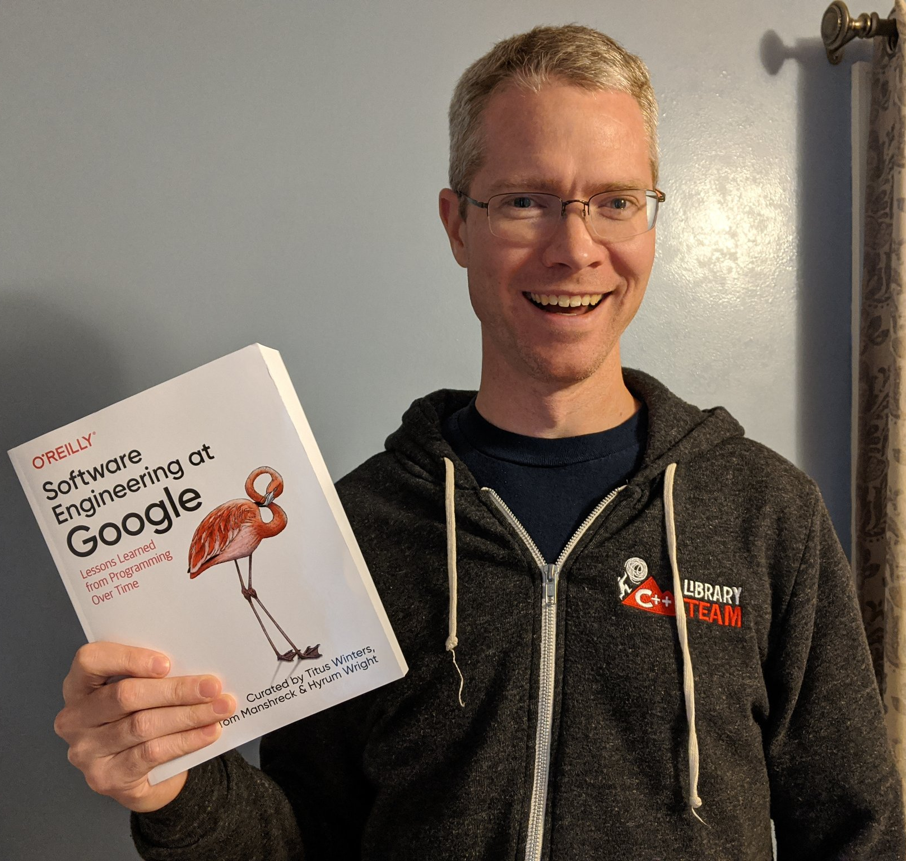
What’s Software Engineering’s Answer?
Hyrum’s Law
“With a sufficient number of users of an API,
it does not matter what you promise in the contract:
all observable behaviors of your system
will be depended on by somebody.”
-Hyrum Wright
For more: see “Software Engineering at Google” Ch 1

Slide 17
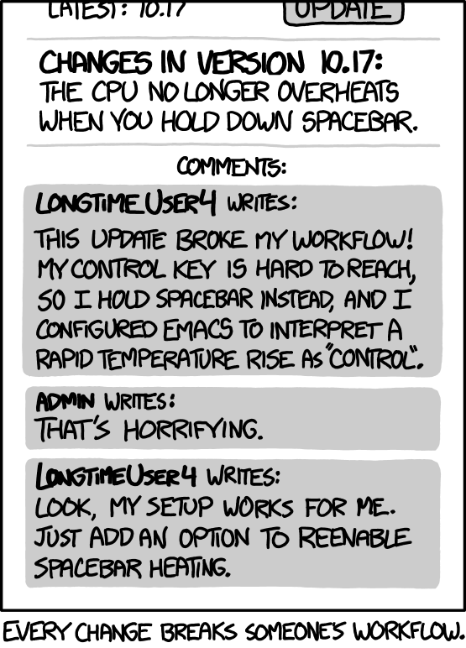
What’s Software Engineering’s Answer?
Hyrum’s Law
“With a sufficient number of users of an API,
it does not matter what you promise in the contract:
all observable behaviors of your system
will be depended on by somebody.”
-Hyrum Wright
XKCD #1172

Slide 18
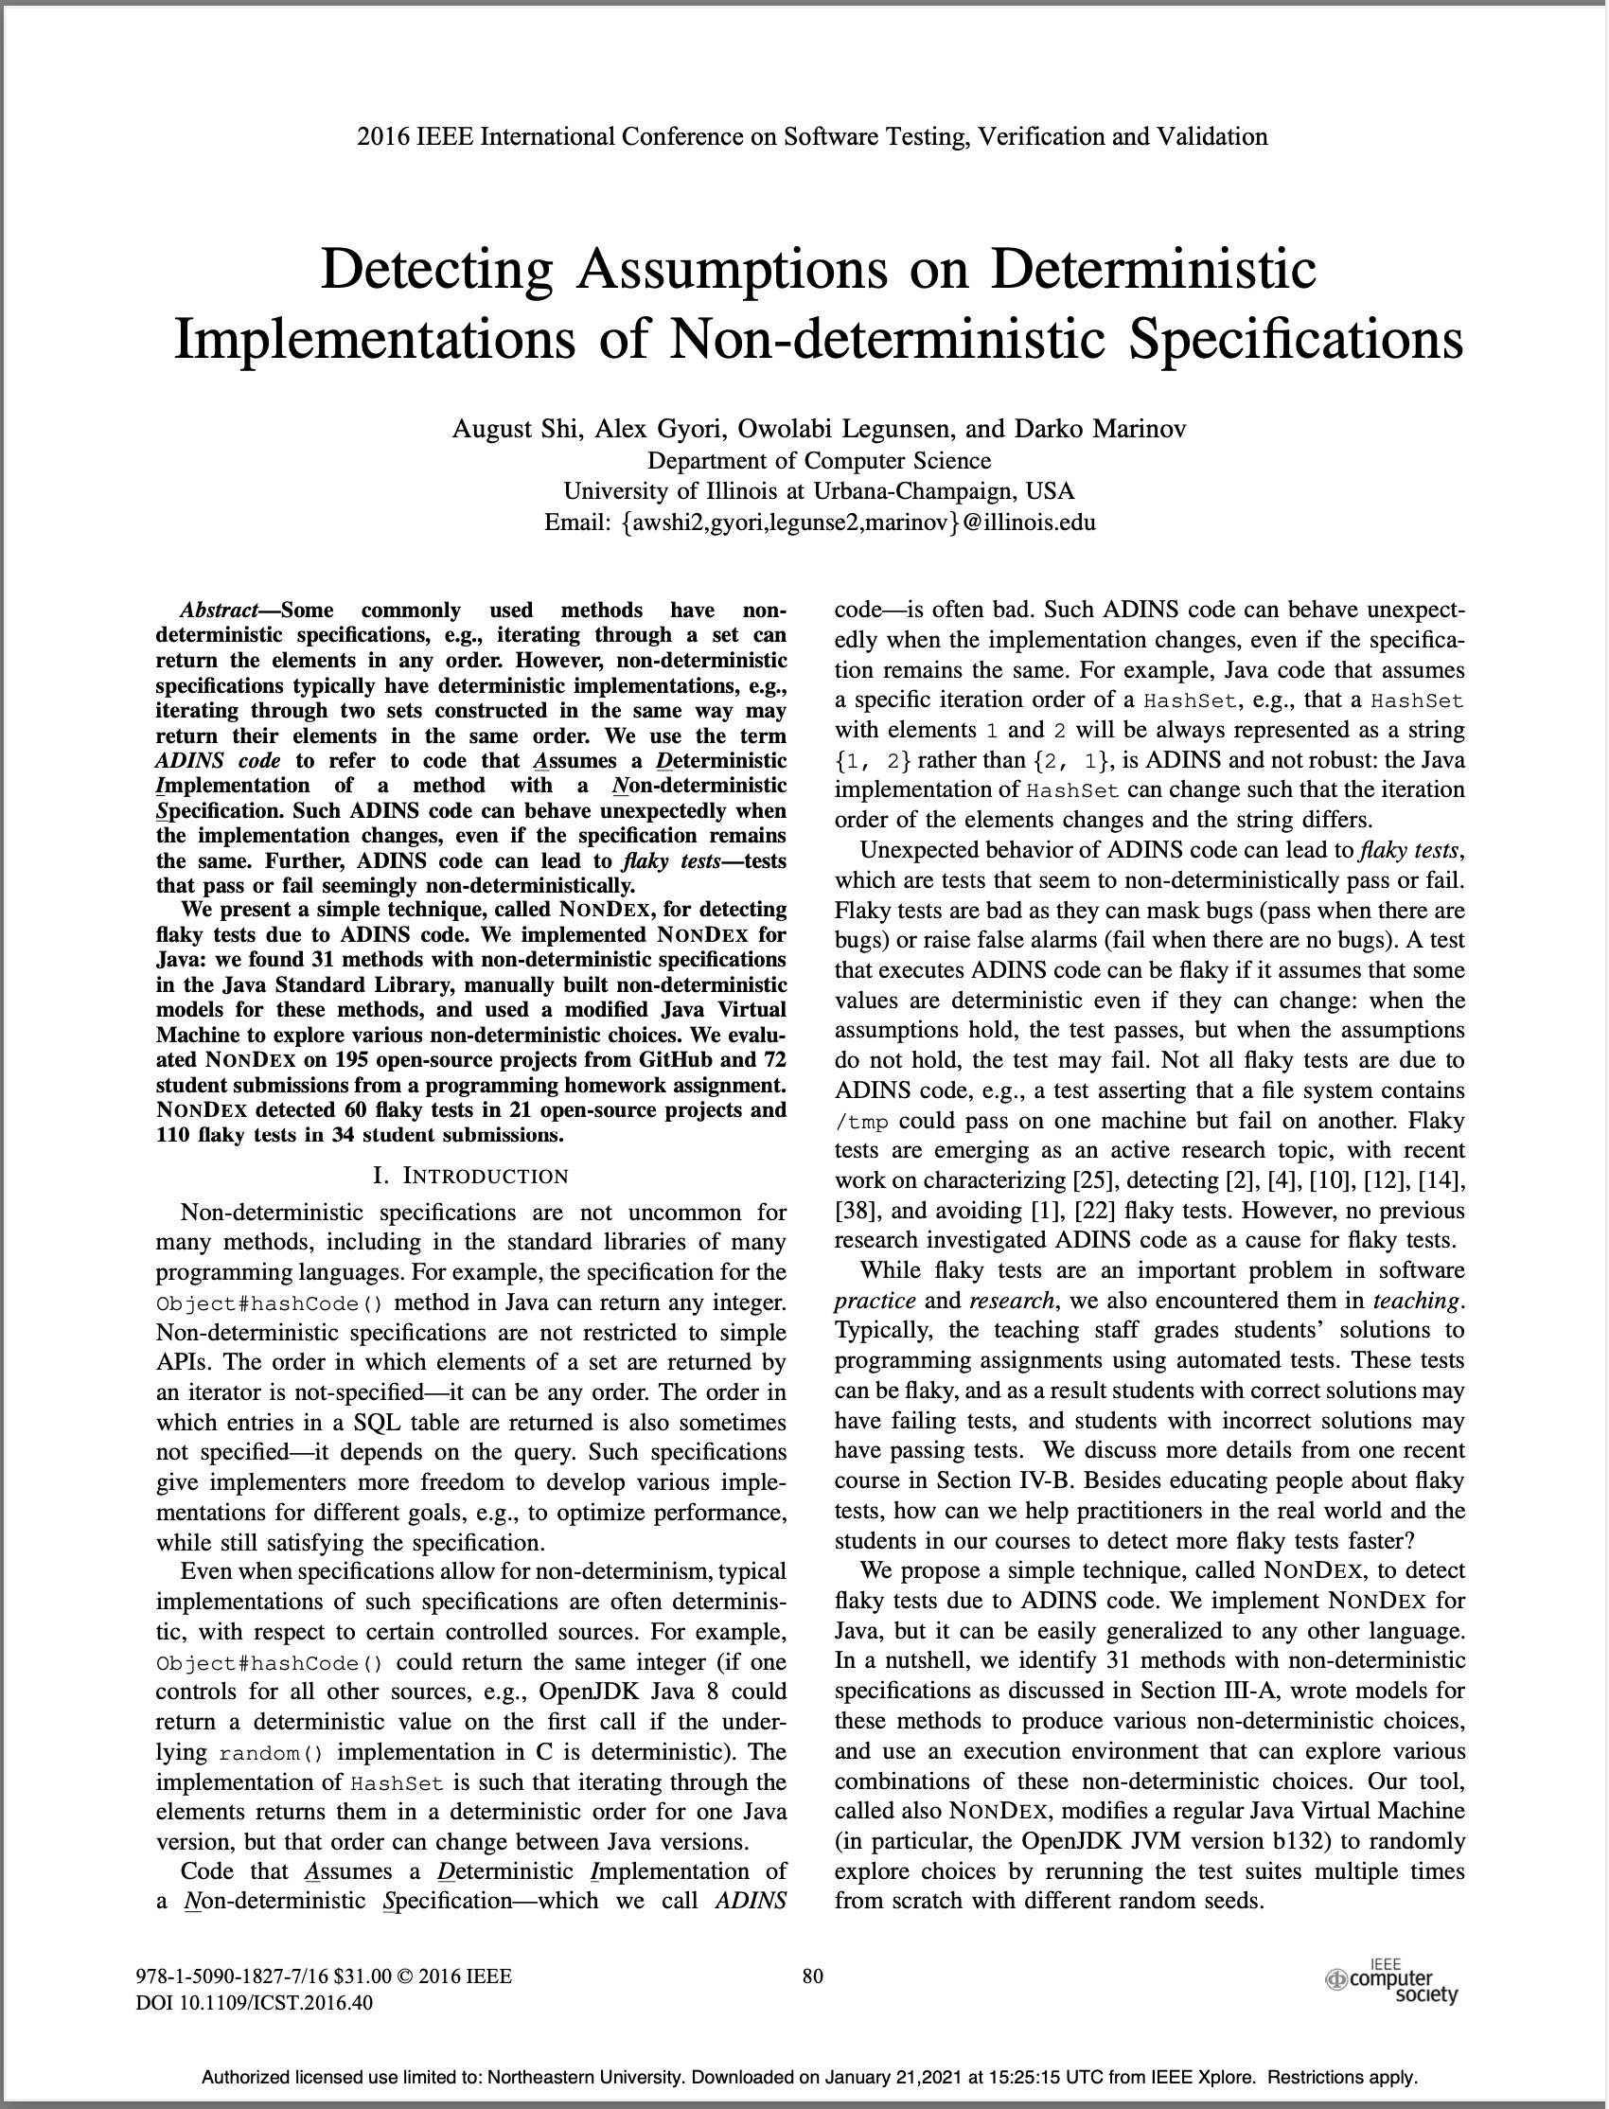
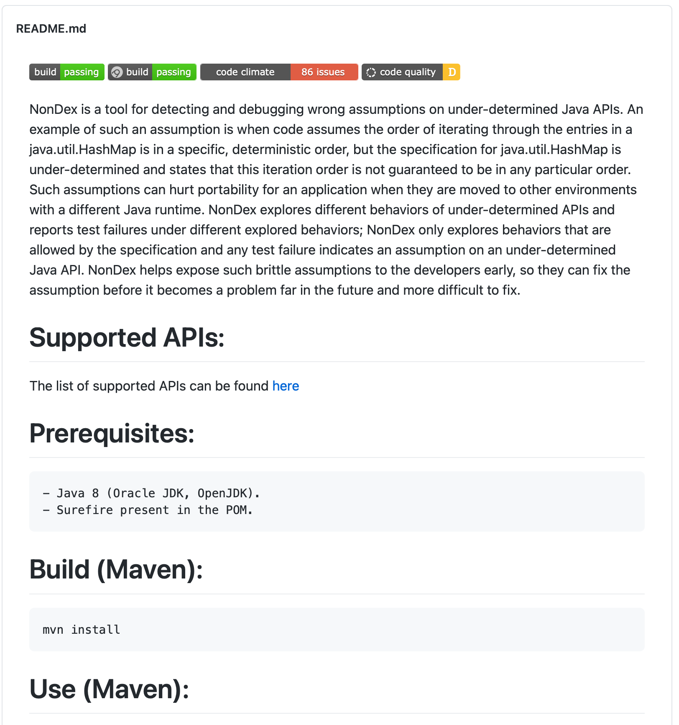
What’s Software Engineering’s Answer?
Automatically detecting this!
https://github.com/TestingResearchIllinois/NonDex

Slide 19
Why be pedantic about software design?
Software Engineering is about People
function calculateFoo(x: number, y: number, increment: boolean): number {
if (increment)
x++;
x *= 2;
x += y;
return x;
}
calculateFoo(3, 5, true) = ? calculateFoo(3, 5, false) = ?
13
8
11
Software engineering tools to the rescue!
2:3 error Expected { after 'if' condition curly
3:5 error Expected no linebreak before this statement nonblock-statement-body-position
3:5 error Unary operator '++' used no-plusplus
3:5 error Assignment to function parameter 'x' no-param-reassign
4:3 error Assignment to function parameter 'x' no-param-reassign
5:3 error Assignment to function parameter 'x' no-param-reassign

Slide 20
Why be pedantic about software design?
What’s wrong with this code?
function anotherExample(value: number): void {
switch (value) {
case 1:
doSomething();
case 2:
doSomethingElse();
break;
default:
doDefaultThing();
}
}
5:5 error Expected a 'break' statement before 'case' no-fallthrough

Slide 21
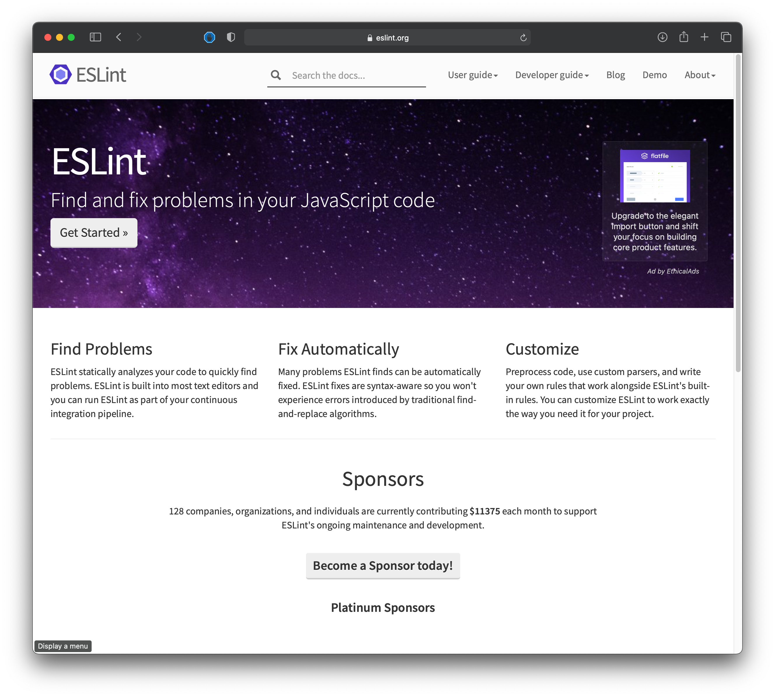
Our first Software Engineering Tool
Linters: your friend, your foe

Slide 22
Review: Design Principles
Five General Principles
1. Use Good Names
2. Design Your Data
3. One method/one job
4. Don't Repeat Yourself
5. Don't Hardcode Things That Are Likely To Change
Five Principles for OO Programming
1. Make Your Interfaces Meaningful
2. Depend only on behaviors, not their implementation
3. Keep Things as Private as You Can
4. Favor Dynamic Dispatch Over Conditionals
5. Favor Interfaces Over Subclassing

Slide 23
Activity: Design Principles and Coding Style
Right now: Review some of your previous coding projects. This could be a homework, a term project, or something from outside of class, so long as it’s something that you can share. Find one or two examples in your code where either:
you used one of the principles and it was helpful
you didn't use one of the principles and it would have helped if you'd used it.
Be prepared to share your code and tell the class
what the relevant principle was and
how it either helped or would have helped.

Slide 24
Activity: Design Principles and Coding Style
Breakout groups
In groups of 4, discuss the design and code style issues that you each found
It’s not necessary that all 4 of you present your code to each other, most important is to have a good discussion
Post your findings in Slack in #section-bell (https://nusespring2021.slack.com)
After 15 minutes, we’ll come back together and share some examples all together

Slide 25
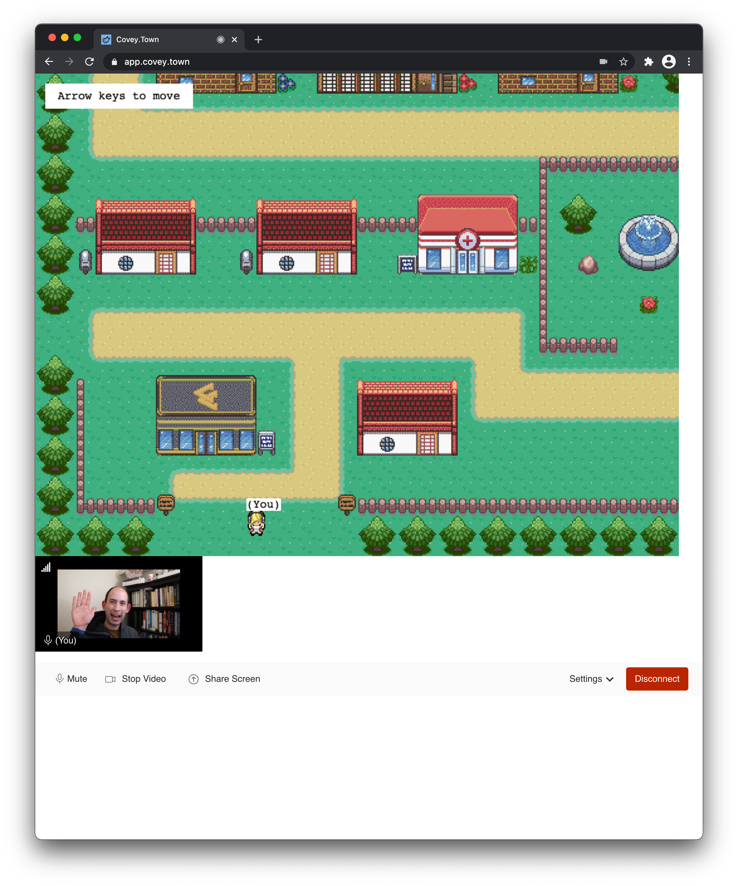
Homework 1 Preview
What we’re building towards…

