Slide 1
CS 4530
Software Engineering
Lecture 2 - Design Documentation: CRC + UML
Jonathan Bell, John Boyland, Mitch Wand
Khoury College of Computer Sciences

Slide 2
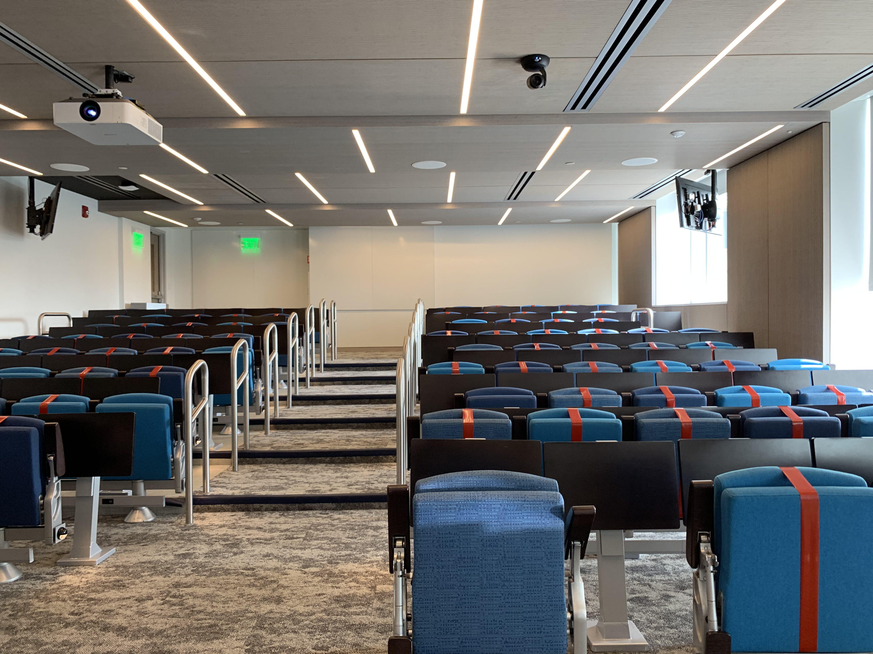
Zoom Mechanics
Recording: This meeting is being recorded
If you feel comfortable having your camera on, please do so! If not: a photo?
I can see the zoom chat while lecturing, slack while you’re in breakout rooms
If you have a question or comment, please either:
“Raise hand” - I will call on you
Write “Q: <my question>” in chat - I will answer your question, and might mention your name and ask you a follow-up to make sure your question is addressed
Write “SQ: <my question>” in chat - I will answer your question, and not mention your name or expect you to respond verbally

Slide 3
Today’s Agenda
HW1 Discussion
Documenting designs with CRC + UML diagrams
Activity: UML

Slide 4
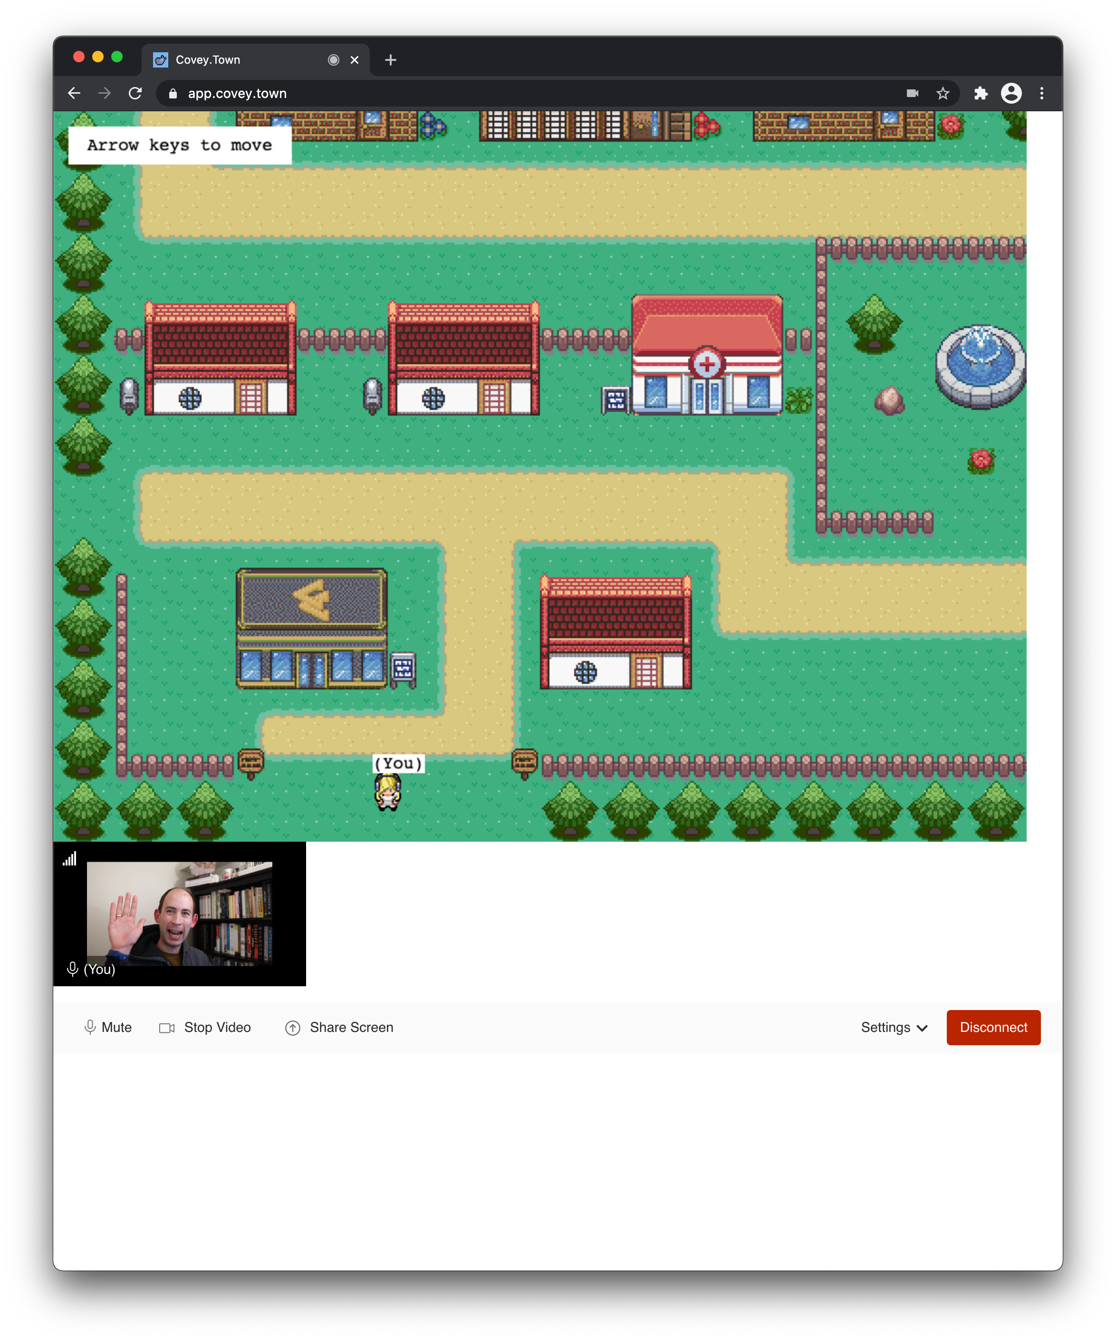
Discussion: HW1

Slide 5
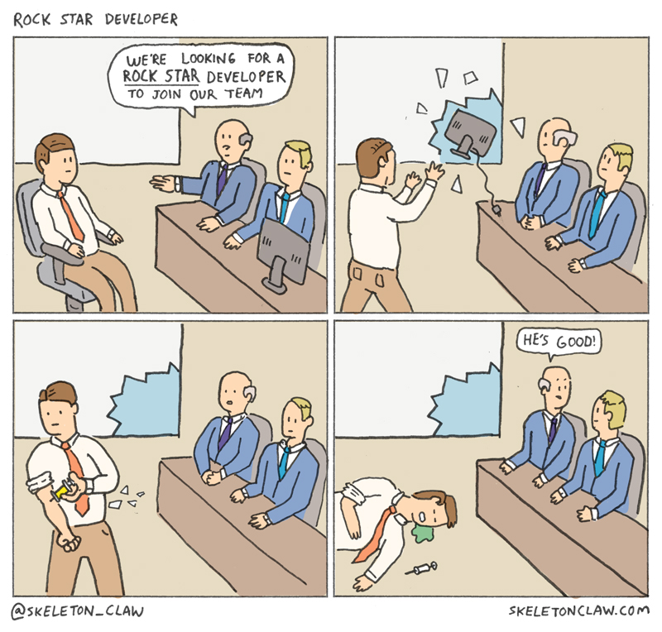
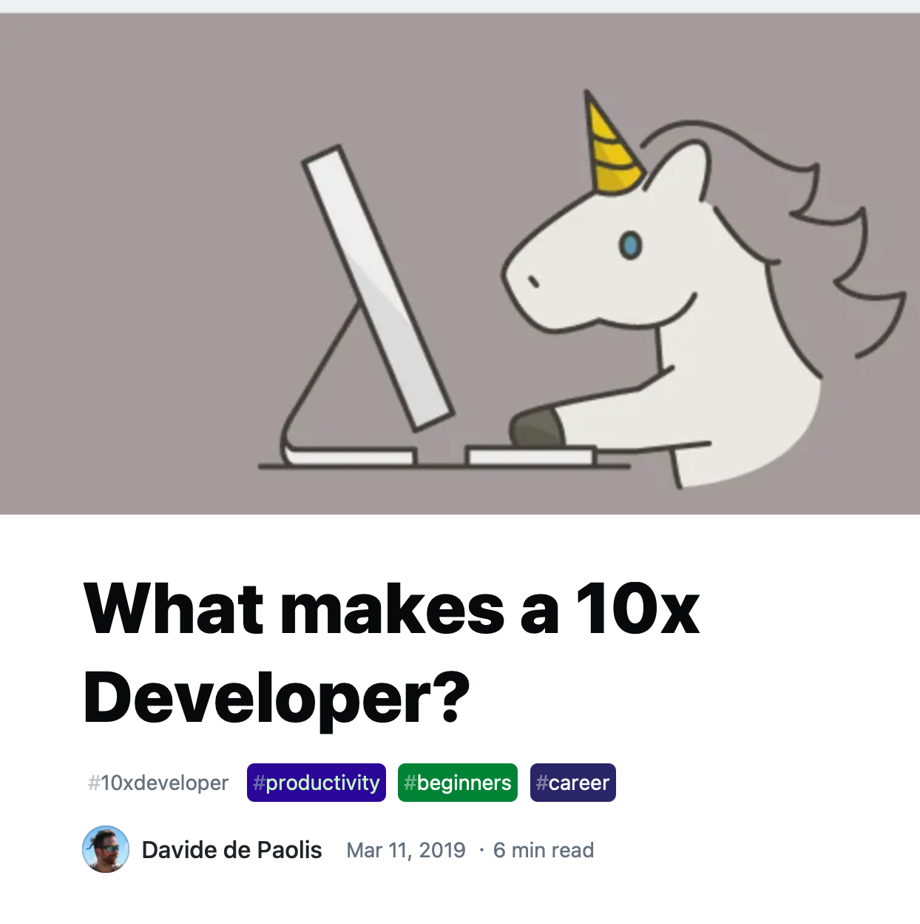
“The 10x Engineer”
AKA “The Rock-Star Engineer,” “The Ninja Developer”
Notes:
Instinct: find and worship idols. Who are our SE idols? Linus Torvalds, Guido Van Rossum, Bill Gates?
Linus didn’t write linux alone: wrote beginnings of PoC Unix-like kernel, show to mailing list, form community, lead people and coordinate work. Not result of his PoC Unix-like kernel, but result of community. Also: what about Unix? Not just Ken Thompson + Dennis Ritchie, but big group at Bell Labs,
Guido Van Rossum dien’t personally create Python: he wrote first version sure (in 1991!), but hundreds of others contributed to later versions, made it what it is now (not to mention package eco-system… num-py!!)
Steve Jobs led a team that built the Mac. Bill Gates might have written a BASIC interpreter, but is probably better known for building an enormous company around MS-DOS
Genius Myth is our tendency to ascribe success of a team to a single person or its leader. Key is that we are able to form a team and collaborate, sharing knowledge

Slide 6
Conceptual Design is Hard
There is “No Silver Bullet” for a 10x improvement
“The essence of a software entity is a construct of interlocking concepts: data sets, relationships among data items, algorithms, and invocations of functions. … I believe the hard part of building software to be the specification, design, and testing of this conceptual construct, not the labor of representing it and testing the fidelity of the representation.”
Fred Brooks, 1987
Notes:
In the 70’s Brooks analyzed software construction failures, coining Brooks’ Law: “Adding manpower to a late software project makes it later.”
He talked a lot about the problems that software engineers faced at the time. 10 years later he wrote a reflective essay, “No silver bullet,” looking at the past decade’s advances in software engineering that promised a 10x improvement in software development. Argues that there is no single fix; the core issue is that there is essential complexity to a program, and that this will remain, discusses importance of good design up-front

Slide 7
Collaboration: The 10x Team
A “Dream Team,” if you will…
“Many eyes make all bugs shallow” (ancient proverb)
Avoid a single point of failure
Notes:
Early detection of issues: “Many eyes make all bugs shallow” - avoid reinventing wheel, plus notice that people who collaborate can move faster by relying on different peoples’ strengths
Bus factor: if only one person on team understands how the prototype works and is hit by a bus (or gets on a bus and moves to another employer, or has any other reason to no longer work on your project), how screwed are you?
(Michael Jordan, Larry Bird, Magic Johnson)

Slide 8
The 10x Team, or the 1/10 Team?
Mythical Man-Month: “adding manpower to a late software project makes it later”
Knowledge sharing needs to scale linearly (or sub linearly) with org growth:
Mentorship
Q&A
Mailing lists
Tech talks
Documentation <— Our focus today
For more on knowledge sharing in teams, see SE@Google Ch 3

Slide 9
Design Documents
Why?
At design time:
Consider alternative solutions
Identify flaws
At implementation/debugging time:
A handy reference
Design documents include…
Goals of design
Implementation strategy
Discussion of alternative designs and their strong and weak points

Slide 10
Design Diagrams - UML Sequence
Improving understanding and understandability
/**
* A handler to process a player's request to join a room. The flow is:
* 1. Client makes a RoomJoinRequest, this handler is executed
* 2. Client uses the sessionToken returned by this handler to make a subscription to the room,
* @see roomSubscriptionHandler for the code that handles that request.
*
* @param requestData an object representing the player's request
*/
export async function roomJoinHandler(requestData: RoomJoinRequest): Promise<RoomJoinResponse>
Covey.Town Frontend
Covey.Town roomJoinHandler
Covey.Town roomSubscription Handler
Twilio Video
Join Room
userName, roomID
Tokens: coveyTown, Twilio
Subscribe to roomID using coveyTown Token
Connect to video room using Twilio Token
Updated room information: players and locations
Video streams from other players
Notes:
Comments in code are one thing, but confusing.
To read:
Start at the top left corner with the "driver" class instance that starts the sequence
Then follow each message down the diagram
Shows objects as lifelines running down the page, with their interactions over time represented as messages drawn as arrows from the source lifeline to the target lifeline
Not intended for showing complex procedural logic

Slide 11
Design Diagrams - UML Sequence
Improving understanding and understandability
Covey.Town Frontend
Covey.Town roomJoinHandler
Covey.Town roomSubscription Handler
Twilio Video
Join Room
userName, roomID
Draw a line for each message, with an arrowhead pointing to the receiving class instance
Tokens: coveyTown, Twilio
Subscribe to roomID using coveyTown Token
Draw a dotted line for each return value, with an arrowhead pointing back to the originating class instance
Connect to video room using Twilio Token
Updated room information: players and locations
Video streams from other players
Notes:
Across the top of your diagram, identify the class instances (objects) by putting each class instance inside a box
If a class instance sends a message to another class instance, draw a line with an open arrowhead pointing to the receiving class instance, labeled with message name and, optionally, parameters
Return value may also be indicated by annotating the calling arrow
Or draw a dotted line with an arrowhead pointing back to the originating class instance, label the return value above the dotted line

Slide 12
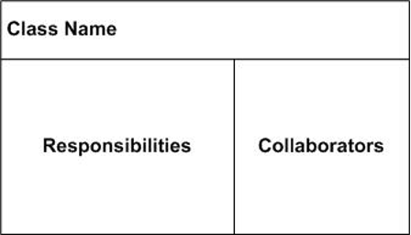
CRC Cards
Each class is a thing, entity or object
Each responsibility is some action the entity needs to do
Collaborators are other classes the entity interacts with, communicates with, contains, knows about, or that otherwise help it perform one or more responsibilities
CRC focuses on the purpose of each entity rather than its processes, data flows and data stores (procedural design)

Slide 13
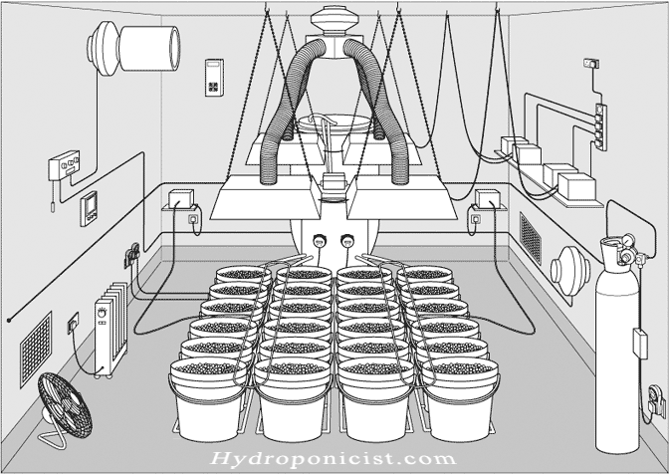
Example: Sensors
Notes:
Let’s assume we are cultivating plants at home, requiring very specific climate conditions (humidity, temperature, …)

Slide 14
CRC Card for TemperatureSensor
// temperatures are measured in Celsius
type Temperature = number
interface TemperatureSensor {
// return the current temperature
// at the sensor location
getTemperature () : Temperature
}
Class Name: | TemperatureSensor (interface)
State: | none
Responsibilities |  | Collaborators
establish interface for thermometers in the system |  | RefrigeratorThermometer
 |  | OvenThermometer
 |  | etc.
 |  | TemperatureMonitor
CRC cards are supposed to be informal, so don’t get hung up on emulating the exact words or the exact layout I've used here.

Slide 15
TemperatureMonitor (1)
class TemperatureMonitor {
constructor(
// the sensors
private sensors: TemperatureSensor[],
// map from sensor to its location
private sensorLocationMap: SensorLocationMap,
private maxTemp: Temperature,
private minTemp: Temperature,
private alarm: IAlarm,
) { }
// sensor in range?
private isSensorInRange (sensor:TemperatureSensor) : boolean {
const temp: Temperature = sensor.getTemperature()
return ((temp < this.minTemp) || (temp > this.maxTemp))
}
Here's a slightly more elaborate TemperatureMonitor
It monitors multiple sensors
And it knows where each sensor is
Better division into one method/one job than our earlier version.

Slide 16
TemperatureMonitor (2)
// if the any of the sensors is out of range, sound the alarm
public checkSensors(sensor:TemperatureSensor): void {
this.sensors.forEach(sensor => {
if (!(this.isSensorInRange(sensor))) {
this.soundAlarm(sensor)
}
})
}
private soundAlarm (sensor) {
const location = this.sensorLocationMap.getLocation(sensor)
this.alarm.soundAlarm(location)
}
}

Slide 17
CRC Card for TemperatureMonitor
Class Name: | TemperatureMonitor
State: | sensors, maxTemp, minTemp, alarm
Responsibilities |  | Collaborators
if any of the sensors is out of range, tell the alarm to sound at its location |  | TemperatureSensor
 |  | SensorLocationMap
 |  | IAlarm

Slide 18
CRC Cards: Where to start?
Building the cards
Find the nouns: entities that “do” actions (classes)
Find the verbs: what gets done, not how (responsibilities)
Find the relationships
Class Name: | TemperatureSensor (interface)
State: | none
Responsibilities |  | Collaborators
establish interface for thermometers in the system |  | RefrigeratorThermometer
 |  | OvenThermometer
 |  | etc.
 |  | TemperatureMonitor
Notes:
How do we know what the classes (entities) are?
Start with user stories or, better, use cases
Find the nouns other than the user (user role) - classes should be the entities that “do” actions, not the actors who initiate actions
Convert plurals to singular, merge synonyms
Beware adjectives - may mean a whole new class, e.g., “car” vs. “toy car”
Beware hidden nouns, e.g., passive voice
“the thing is activated” = “SOMETHING activates the thing”
Some nouns may be attributes of entities, not themselves entities, e.g., “the radius of a circle” - here the circle is an entity and the radius is an attribute of the circle, it has no meaning as a standalone entity
Verbs: Say WHAT gets done, not HOW it gets done
Turn passive verbs into active verbs, as above
“the thing is activated” = “SOMETHING activates the thing”
The classes and responsibilities create a vocabulary for discussing the design
Where do the collaborators come from?
Find any relationships or associations among nouns (not necessarily symmetric, can be one-way)
Classes and Collaborators do not need to correspond to code classes, types or data structures, can be modules, packages, libraries, even files, databases, devices. CRC does not need an object-oriented programming language

Slide 19
CRC Cards: Putting them to use
Not just static objects!
Class Name: | SensorLocationMap
State: | Map from Sensors to their Location
Responsibilities |  | Collaborators
Maintain the map from Sensors to their Location |  | TemperatureMonitor
Class Name: | TemperatureMonitor
State: | sensors, maxTemp, minTemp, alarm
Responsibilities |  | Collaborators
if any of the sensors is out of range, tell the alarm to sound at its location |  | TemperatureSensor
 |  | SensorLocationMap
 |  | IAlarm
Class Name: | TemperatureSensor (interface)
State: | none
Responsibilities |  | Collaborators
establish interface for thermometers in the system |  | RefrigeratorThermometer
 |  | OvenThermometer
 |  | etc.
 |  | TemperatureMonitor
Class Name: | Ialarm (interface)
State: | none
Responsibilities |  | Collaborators
Interface for classes that will sound an alarm |  | TemperatureMonitor
 |  | all implementations of IAlarm
Class Name: | FireAlarm
State: | socket for communicating with Fire Dept
Responsibilities |  | Collaborators
when sounded, call the FireDept |  | IFireDept
when FireDept responds, turn off alarm
Notes:
Animate them: move index cards on a table or sticky notes on a board. Make sure everything is a responsibility of some class, and figure out what each class needs from other classes to fulfill its responsibilities
When “the system” does something, that means some class in the system does it - there should not be any global master that does everything and/or is related to everything else. Give up global knowledge of control and rely on local knowledge of objects to accomplish their tasks. (This does not mean some classes cannot be singletons = there’s no more than one instance)
Then debug the CRC cards
● Remember classes are nouns that “do” operations, not the actors who initiate operations
● Split classes with too many responsibilities
● Combine classes with too few responsibilities
● Remove redundancy
● Remove classes with only CRUD operations (create, read, update, delete) that don’t “do” anything

Slide 20
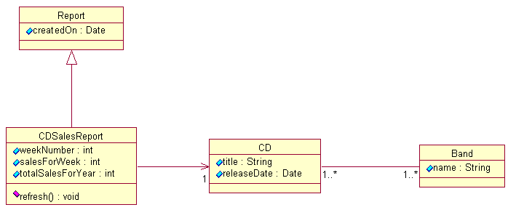
UML Class Diagrams
Graphically shows relationships between entities
Not necessarily a 1:1 correspondence to code: good for domain modeling
Example: reporting on compact disc sales
Notes:
A class is depicted on the class diagram as a rectangle with three horizontal sections (“compartments”)
The upper section shows the class's name
The middle section contains the class's attributes, optionally with initial values
The lower section contains the class's operations or behaviors (methods)
May be abbreviated to show just name, or just name and attributes

Slide 21
UML Class Diagrams
Indicate relationships using different kind of arrows:
Generalization (is a)
Association (has a)
Generalization
One-way
association
Two-way
association
Notes:
A class is depicted on the class diagram as a rectangle with three horizontal sections (“compartments”)
The upper section shows the class's name
The middle section contains the class's attributes, optionally with initial values
The lower section contains the class's operations or behaviors (methods)
May be abbreviated to show just name, or just name and attributes

Slide 22
UML Class Diagrams: Cardinality
Instructor
teaches ►
Course
Any given instructor teaches 1 course. Any given course is associated with one instructor.
1
1
Instructor
teaches ►
Course
Any given instructor teaches at least 1 and up to 10 courses. Any given course is associated with one instructor.
1
1..10
Instructor
teaches ►
Course
Any given instructor teaches 1 or more courses. Any given course is associated with one instructor.
1
1..*
Instructor
teaches ►
Course
If no cardinality is specified, it defaults to 1.
1..*
Notes:
Note: the solid triangle indicates how a human should interpret the relationship ("Instructor teaches Course"). It does not indicate navigability (from an instructor, can you find the list of courses they teach?)

Slide 23
UML Class Diagrams: Generalization
Northeastern Person
more generic as you move up
more specific as you move down
more specific inherits attributes and operations from the more general
may specialize attributes and operations
Employee
Student
Faculty
Graduate
Staff
Undergraduate

Slide 24
UML Class Diagrams: Aggregation
Aggregation is an association that means a “whole/part” or “containment” relationship.
The distinction between association and aggregation is not always clear.
Don't stress about this: If in doubt, notate the relationship as a simple association.
Notes:
While the distinction between association and aggregation is not always clear, it is important that members of a project team agree about the use of the term. In general, aggregation is reserved for associations with a strict hierarchy.
Composition is a still stronger hierarchical association. Composition implies that the contained object’s lifetime is controlled by the containing object. Thus a car-engine association is aggregation, because the engine might be removed from one car and placed in another. The car-paint association is composition, because the paint does not have an independent lifetime.
By contrast, the car-garage association in neither aggregation nor composition. Neither can be considered part of the other in any sense.

Slide 25
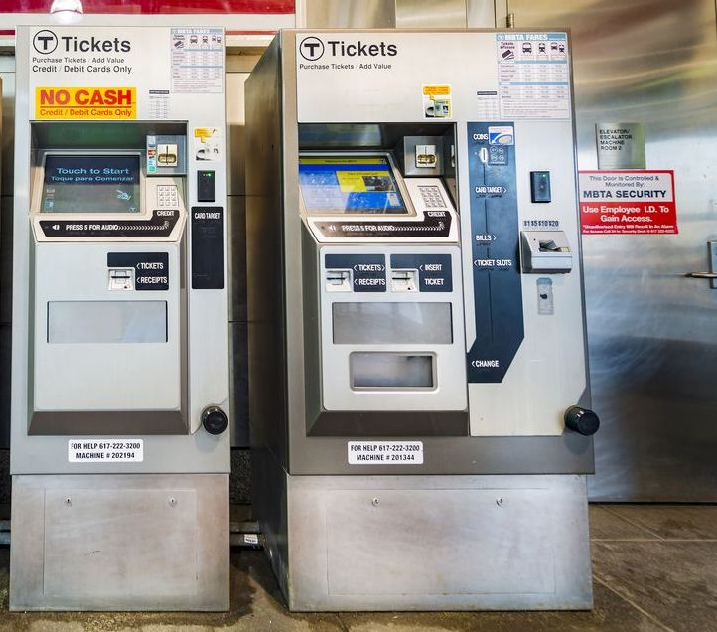
UML Activity: TVM
Ticket Vending Machines
TVMs accept cash and credit cards as payments to sell fares, which are loaded onto passes
TVMs sell two kinds of fares:
Time-based fares
Value-based fares
Fares can be loaded onto passes, passes can be:
CharlieCard
CharlieTicket
Your task: Create a UML class diagram that represents:
The TVM itself; the two kinds of fares; the two kinds of passes
Notes:
Your task is to design a set of classes to represent the behavior that is supported by CharlieCard vending machines (the vending machines that sell transit tickets in Boston; if you are not familiar with these exact machines, the problem is applicable to other mass transit systems). Your vending machine sells the following kinds of fares:
* Time-based passes - passes with a time-based validity period (daily, weekly and monthly) tickets that are good for unlimited rides within their validity period. The expiration date of a time-based pass is calculated from the first time that the pass is actually used to charge a ride --- a 7-day pass sold today but not used for a month will be valid for 7 days from the first day that it is used.
* Value-based passes - passes with a pre-loaded balance (in US Dollars) that are good for a set number of rides based on the cost of the ride and the amount loaded onto the pass. For instance, a pass might be loaded with $20. Assume that each ride costs the same flat fare ($2.40).
When riders purchase a pass, they have the choice to load that pass onto a physical card that they already have ("reload" it), or select to have a new physical card issued for the pass. There are two physical card options:
* CharlieCard - a reusable plastic card that is desigend to be re-used for years. Your vending machine can reload CharlieCards that riders already have in their possession, but can not issue new cards.
* CharlieTicket - a paper ticket that is not as physically durable as the CharlieCard, but can nonetheless be reloaded. Your vending machine can issue new CharlieTickets and reload existing CharlieTickets.
You do not need to worry about other peculiar details of Boston's transit system (e.g. the distinction of the commuter rail or ferry from the rest of the system, within-system transfers, or discounts based on disability or age).

Slide 26
This work is licensed under a Creative Commons Attribution-ShareAlike license
This work is licensed under the Creative Commons Attribution-ShareAlike 4.0 International License. To view a copy of this license, visit http://creativecommons.org/licenses/by-sa/4.0/
You are free to:
Share — copy and redistribute the material in any medium or format
Adapt — remix, transform, and build upon the material
for any purpose, even commercially.
Under the following terms:
Attribution — You must give appropriate credit, provide a link to the license, and indicate if changes were made. You may do so in any reasonable manner, but not in any way that suggests the licensor endorses you or your use.
ShareAlike — If you remix, transform, or build upon the material, you must distribute your contributions under the same license as the original.
No additional restrictions — You may not apply legal terms or technological measures that legally restrict others from doing anything the license permits.

